Slide 1

Smart Dashboard
Internee: Junior Edouard
Student #: 519516
School: Inholland University of Applied Sciences
School Supervisor: Vera Hollink
Company: MM Guide
Company Supervisor: Erik Verhoeven

Slide 2
Table of Content
MM Guide
Project introduction
Main question
Sub-questions
Execution & Tools
Conclusion
Live Demo
Tips

Slide 3
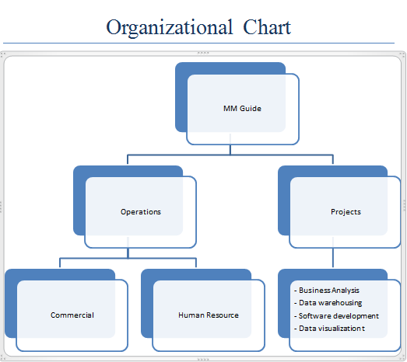
MM Guide
Small I.T. Company established since 1995.
Flat organization split in two sections:
Operations
Projects
Has 29 employees:
In-house workers
Onsite workers

Slide 4
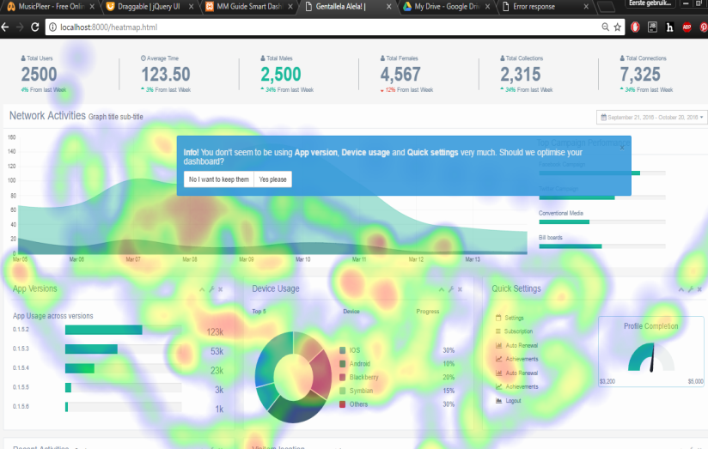
Project Introduction
Client (MM Guide) problem: Pervious dashboard:
No connection to a database
No user interaction
No intelligence
Main Question of the project:
How can the current dashboard be improved to make widget suggestions on relevant information dynamically by filtering and representing data?
Sub-questions to answer the Main question:
How can one measure behavior of user’s interaction with the dashboard?
Base on click patterns, how can relevant information be determined and displayed on the dashboard?
What technique can be used in filtering the big data on the basis of the structured data?
Previous dashboard with Heatmap implementation

Slide 5
Execution & Tools
Sub-Q1: How can one measure behavior of user’s interaction with the dashboard?
Method: Literature review
Tools: Use JQuery (JavaScript library).
Option chose: Create methods using JQuery to register name of widgets and number of clicks in a table.
Result: Widget table was created registering name of the widget and number of clicks.
Sub-Q2: Base on click patterns, how can relevant information be determined and displayed on the dashboard?
Method: Observation , Proof of concept
Tools: JQuery (JavaScript library).
Result: sorting function arranging the widgets based on most clicks to the least.
Sub-Q3: What technique can be used in filtering the unstructured data on the basis of the structured data?
Method: Literature review, Proof of concept
Tools: MySQL, PHP language, Twitter Archiver, PHP Google Sheets API
Result: A Filter sheet with structured data filtering the big data set.

Slide 6
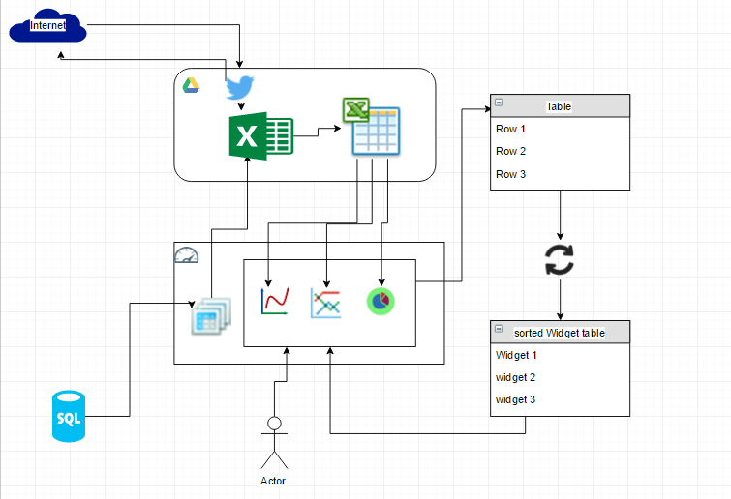
Conclusion
By answering all 3 of the sub-questions I was able:
Create an algorithm using the data collected from the widget table that was implemented to calculate most clicked widget.
Implemented a method that presented the relevant data based on the algorithm mentioned previously on to the smart dashboard sorting the widgets in the order of the most clicked.
A database was also created in order to store the clients structured data within a company. This generated the topic categories that were used to filter and select the big data for the dashboard to display information that had been of interest to the user.
Thus improving the dashboard system to allowing MM Guide’s future clients to interpret large data sets through visualization
Smart Dashboard system Diagram

Slide 7
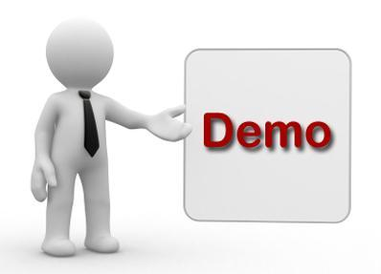
Demo Presentation

Slide 8
Tips for future improvement
Create a page that will allow user to generate graph manually.
Enhance the security For the Smart dashboard.

Slide 9
End of Presentation
Questions?

